Slide 1
Starter – Who can remember?
Imamate
Tawhid
Al Qad’r
Akirah
The afterlife Allah’s plan or predestination
Oneness of Allah Allah’s messengers
Belief in Imams Allah’s guidance to humans
Beings made from light Allah’s justice
Prophethood
Al - Adl
Holy Books
Angels

Slide 2
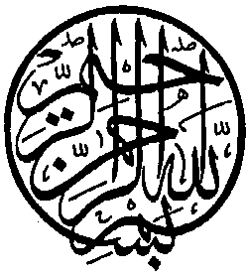
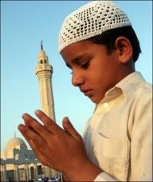

Lesson Objectives:
To be familiar with core beliefs about Allah’s nature.
To engage with philosophical language.
To discuss potential philosophical contradictions and issues about Allah’s nature.

Slide 3
The Nature of Allah – Remember that Sunni and Shi’a Islam agree on these.
Tawhid
Oneness of Allah
Immanence
The belief that Allah is ‘inside’ creation, meaning He works in the world.
Transcendence
The belief that Allah is ‘outside’ creation, meaning Allah is not restricted by the laws of the universe.
Omnipotence
The belief that Allah is all-powerful
Beneficence
The belief that Allah is all-loving
Mercy
The belief that Allah is the source of all mercy and compassion. Allah forgives sinners.
Fairness
The belief that all that Allah does is fair.
Justice
The belief that Allah is the source of justice and always acts justly.

Slide 4
Thinking about Allah- The Shahadah or declaration of faith contains the underpinning belief about the nature of Allah.
Remember both Sunni and Shi’a Muslims agree on the Shahadah as a ‘declaration of faith’.
The Shahadah:
“I bear witness that there is no god but Allah, and Muhammad is the messenger of Allah.”
This declaration of faith sums up the main belief of Muslims about Allah.
All other beliefs about Allah and all other Islamic teachings come back to this.
Allah is one.
Shi’a add “…and Ali was the representative (friend) of Allah”

Slide 5
The names of Allah .
In the Qur’an and Hadith (Muhammad’s sayings) there are many ‘names’ used to describe Allah.
Although different lists have different names, often they are referred to as ‘the 99 names of Allah’.
Allah is too great to be described fully by these names but they remind Muslims of Allah’s qualities.
They aid Muslims in prayer when meditating or contemplating on Allah’s nature.
There is a danger of thinking of Allah as a ‘perfect human’ and the Qur’an reminds Muslims:
“No vision can grasp Him., but His grasp is over all vision.” Surah 6 :103.
* For this same reason it is forbidden to draw a picture of Allah – this could lead to idolatry or the worship of the art rather than Allah. Muslims call this ‘shirk’.

Slide 6
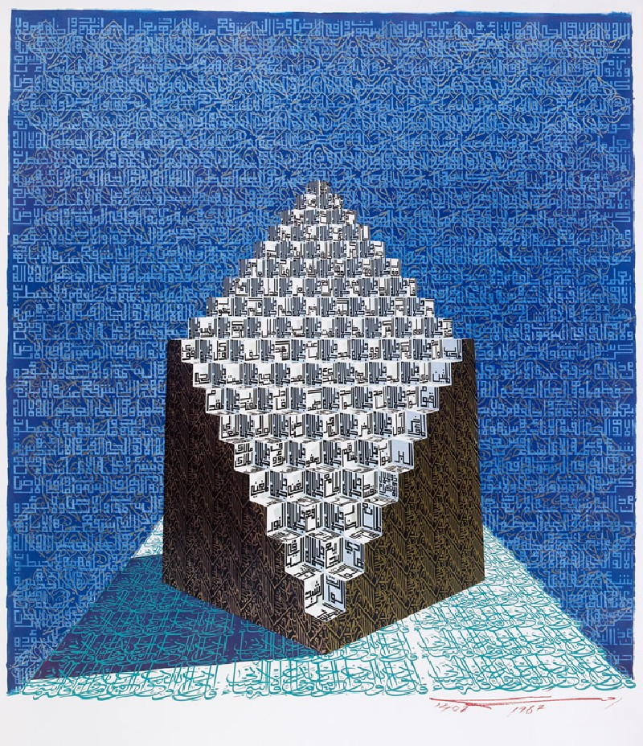
Look at the picture. It is a famous painting of the 99 names of Allah by the Muslim artist Ahmed Mustafa (1987). It is called “The attributes of Divine perfection.”
Remember Islam forbids any drawing of Allah!
Task - discuss in pairs:
Do you like the painting? Why?
What do you think of when you look at it?
How does it make you feel?
How effective is the painting in making you think about Allah?

Slide 7
Sorting activity – take a look at the selection of names for Allah on your sheet.
Use 3 colours to sort the names into categories – one for ‘Intimate or personal’, one for ‘Awe inspiring or impersonal’ and one for ‘both’.
Pick 3 of the names, one from each category. Suggest a situation where a Muslim may think about this name or quality. E.G. ‘Allah the Forgiver’ when they have done something bad.
Do you think having all these ‘names’ helps or hinder Muslims to understand Allah? Give two reasons for your views.

Slide 8
The Last
The Firm
The Wise
The Mighty
The Creator
The Finder
The Manifest
The Loving
The forgiver
The Knower
The Avenger
The Peace
The Friend
The Humbler
The Trustee
The Truth
The Life-Giver
The Patient
The Merciful
The Living
The Incomparable
The One
The Compassionate
The Judge
The eternal
The First
The Generous
The Repairer
The Powerful
The Light
The Provider
The Watcher
The Responder
The Hidden
The Majestic
The Gentle
The Just
The Guide
The King
The Protector
Notes:
Print on A4 – then 2 in 1 on printer to make them A5.

Slide 9
Allah’s Immanence and Transcendence
Immanence
The belief that Allah is ‘inside’ creation, meaning he works in the world.
Transcendence
The belief that Allah is ‘outside’ creation, meaning Allah is not restricted by the laws of the universe.
An easy way to help you remember these two terms:
Immanent – means ‘now’.
Transcend – ‘above or beyond’.
These are two opposing ideas about Allah. Both Shi’a and Sunni Islam teaches that Allah is both.
It is a mystery how this can be – but remember humans can’t know everything about Allah!
Task:
In pairs discuss ‘what does it mean to be both immanent and transcendent’?
What do you think this means for Muslims?
“God can’t be both ‘in and out’ of creation.” Do you agree? Be ready to give verbal feedback.

Slide 10
A summary of the nature of Allah .
What you need to know for the GCSE:
Allah is one (Tawhid).
Islam prohibits the drawing of Allah, this could lead to ‘shirk’.
Allah has many qualities, often described in His 99 names.
Sunni Islam traditionally understands these literally.
Shi’a Islam traditionally understands these allegorically or metaphorically.
Allah is the Creator of the Universe.
Allah has a plan for His creation, including humanity.
What you need to know for the GCSE:
Allah is omniscient – He knows everything.
Allah is omnipotent – He can do anything (all – powerful)
Allah works within creation (Immanent)
Allah is not governed by the laws of the universe (transcendent)
Allah is the source of all goodness, and this includes justice and compassion
Allah cares for His creation – this is why He has sent His revelation (Qur’an).

Slide 11
And to finish . . . What’s that word ? ? ?
Tawhid
Oneness of Allah
Immanence
The belief that Allah is ‘inside’ creation, meaning He works in the world.
Transcendence
The belief that Allah is ‘outside’ creation, meaning Allah is not restricted by the laws of the universe.
Omnipotence
The belief that Allah is all-powerful
Beneficence
The belief that Allah is all-loving
Mercy
The belief that Allah is the source of all mercy and compassion. Allah forgives sinners.
Fairness
The belief that all that Allah does is fair.
Justice
The belief that Allah is the source of justice and always acts justly.

